Slide 1
Common Security Issues
jnlin

Slide 2
Security Principles
Network Security is a very very big issue, can not full covered in this course
CSO: Chief Security Officer
Security is time-consuming
One Time Password
Forced splitting internet and intranet
EC sites in Taiwan
Long password
KISS: Keep it simple and stupid
Notes:
https://www.ithome.com.tw/node/48641

Slide 3
Network Security Threats
Virus / Torjans
Adware / Spam
Phishing / Fraud
Hijacking
Social Engineering / APT
Denial of Service Attacks
……

Slide 4
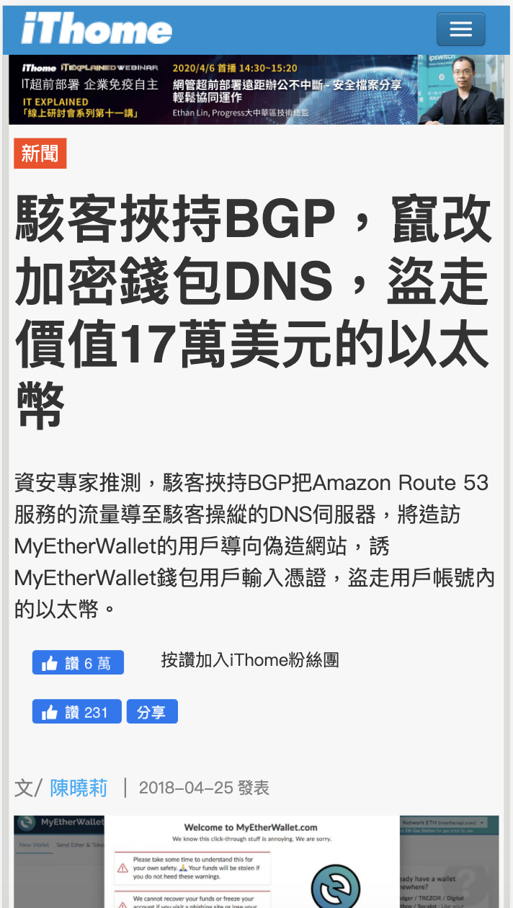
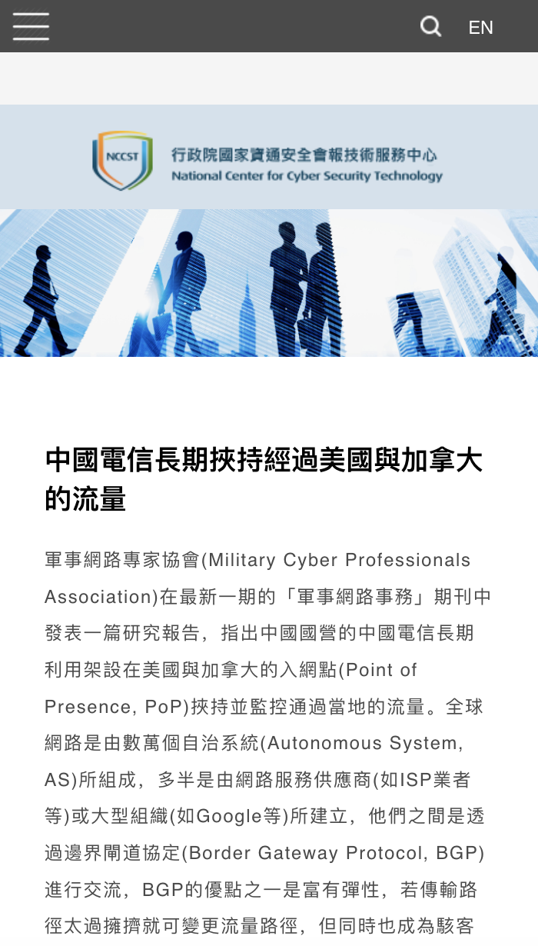

Slide 5
The ideas
Multiple layers of protection
DMZ
Splitting permission of users
Principle of least privilege
Protected Network (e.g. VPN)
Intrusion Detection
Firewalls
WAF
Auditing
Logging

Slide 6
OWASP
The Open Web Application Security Project
https://owasp.org

Slide 7
OWASP Top 10 Security Risks
Published every 3 years
The latest is 2017 version

Slide 8
Injection
Unproper escaping of input
Cause data leak or data loss
Examples
SQL injection
Javascript injection
XSS (Cross-site Scripting)
Question: How to prevent it?

Slide 9
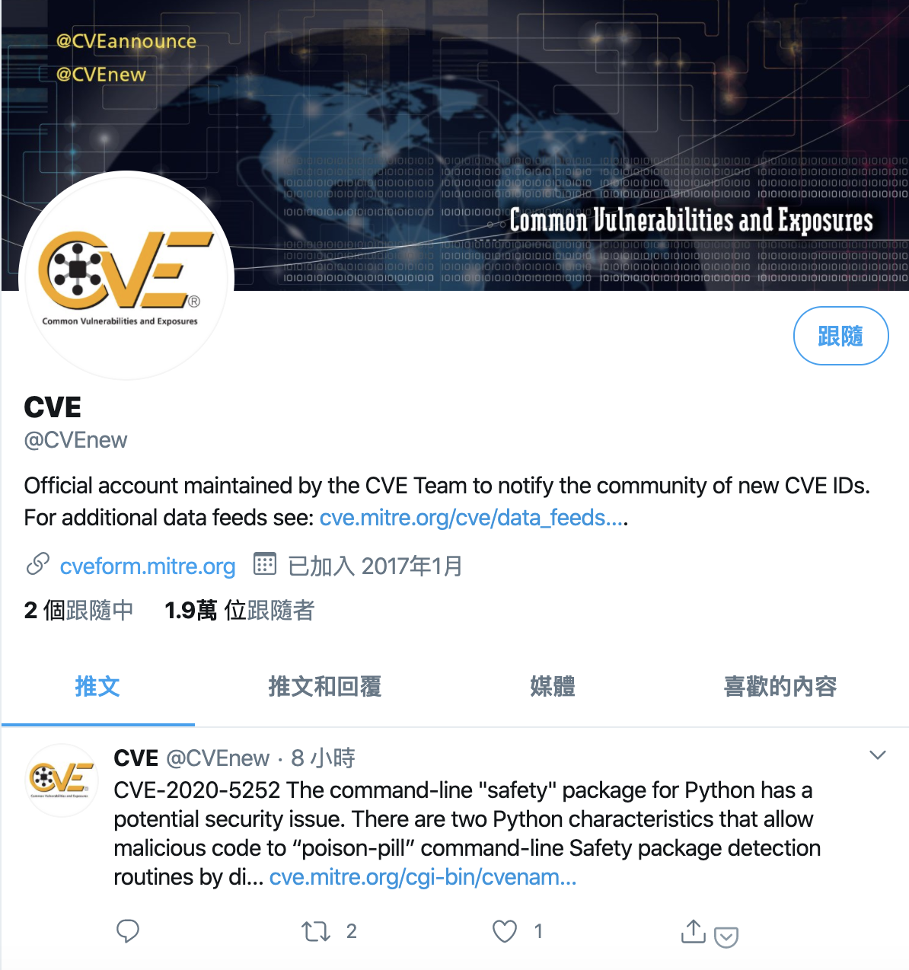
CVE: Common Vulnerabilities and Exposures
CVE® is a list of entries for publicly known cybersecurity vulnerabilities.
Subscribe the RSS feed

Slide 10
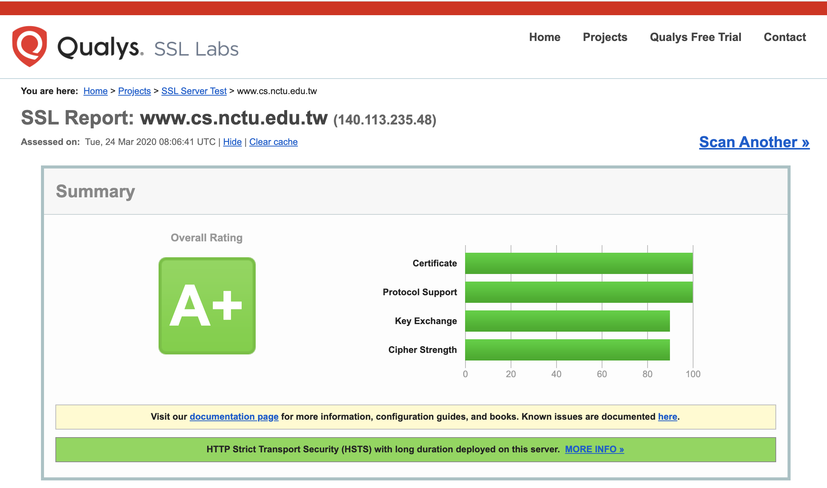
SSL Server Test
Test the SSL configuration and potential risks
https://www.ssllabs.com/ssltest/

Slide 11
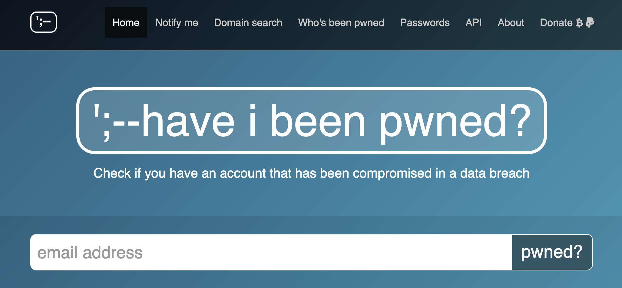
Have I been pwned?
Test if your email & password leaked
https://haveibeenpwned.com/

Slide 13
Static analysis
A testing methodology that analyzes source code to find security vulnerabilities
Human review needed
Can not find authentication problems, access control issues, insecure use of cryptography
Large number of false positives
Difficult to “prove” that an identified security issue is an actual vulnerability.
https://owasp.org/www-community/Source_Code_Analysis_Tools

Slide 14
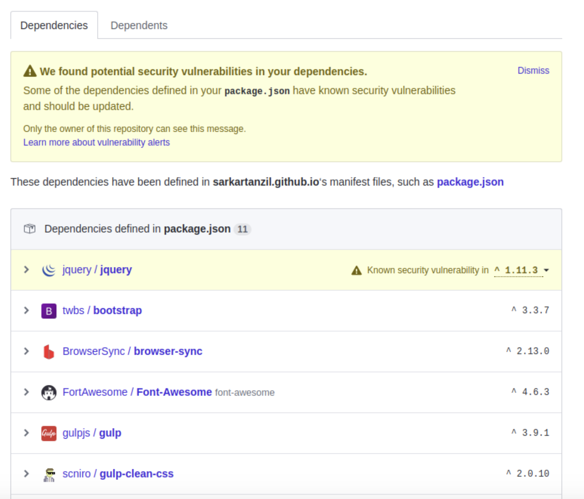

Slide 15
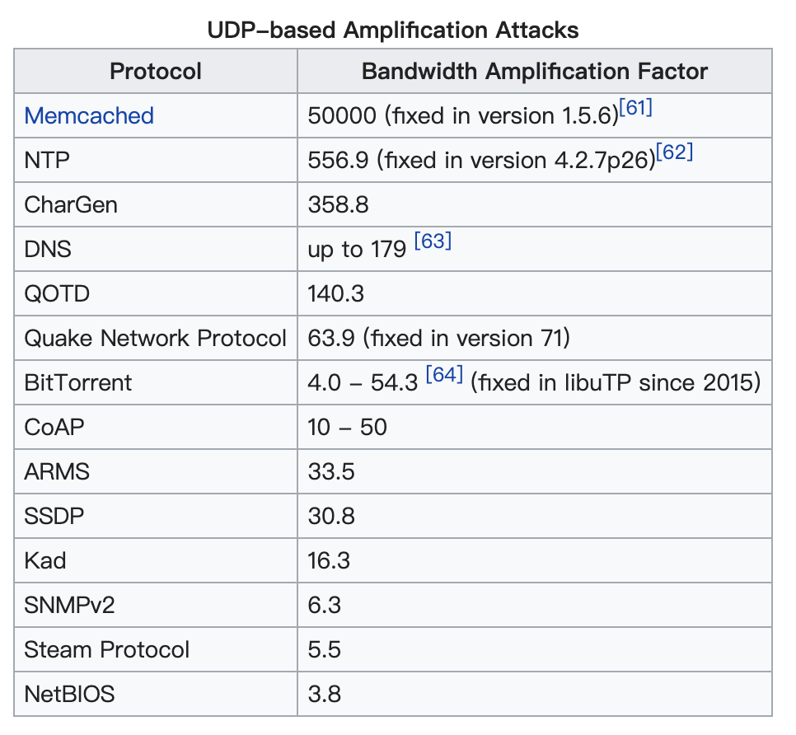
DoS: Denial of Service Attacks
Make a network resource unavailable to its intended users by temporarily or indefinitely disrupting services of a host connected to the Internet
Methods
Software bugs
Bad designed / implemented protocol
SYN Flooding
Amplification Attacks
Exhaust all resources

Slide 16
DDoS: Distributed Denial of Service (1)
The incoming traffic flooding the victim originates from many different sources
Maybe the sources have normal behavior
Difficult to block all attacking source

Slide 17
DDoS (2)
Botnet
Comprised computers with malicious software (zombies)
Launch attacks if the botnet owner gets paid
Clean Pipe
Multiple layers of filter of DDoS traffic
Lots of IDSs & IPSs
“Wash” traffic and direct clean traffic to servers
False positive

Slide 18
Conclusion
Safe design lowers the security risk
Multiple layers of protection
Encrypt matters
Logging and auditing
Keep systems updated
Vulnerabilities feed
Human review

